Slide 1
2024 carbon budget update and discussion
January 14, 2025

Slide 2
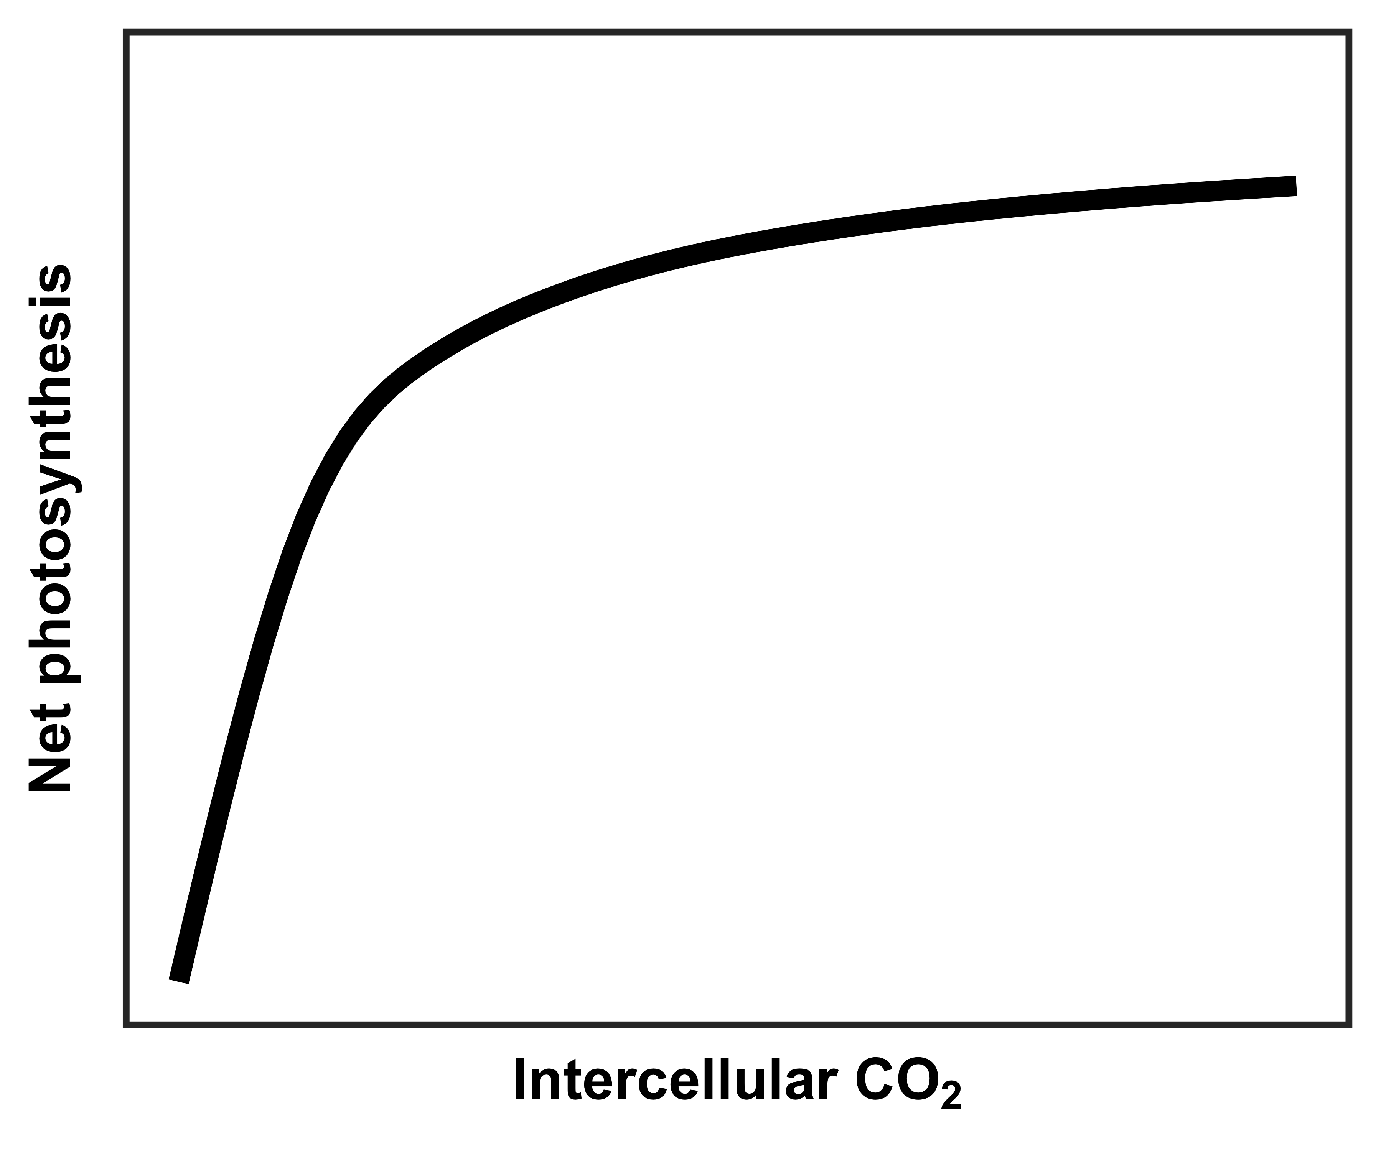
Field season summary
A/Ci curves on all individuals in plots 3, 5, 6 every two weeks
First half of total sample size one week, second half the second week
Relative chlorophyll content, allometry measurements immediately following each A/Ci curve
We do not have repeat measures for all Mai throughout growing season due to trampling/treefall/tree shaving incidents
Challenging for constructing carbon budget at individual scale
Solution, for now: aggregate measurements at treatment scale

Slide 3
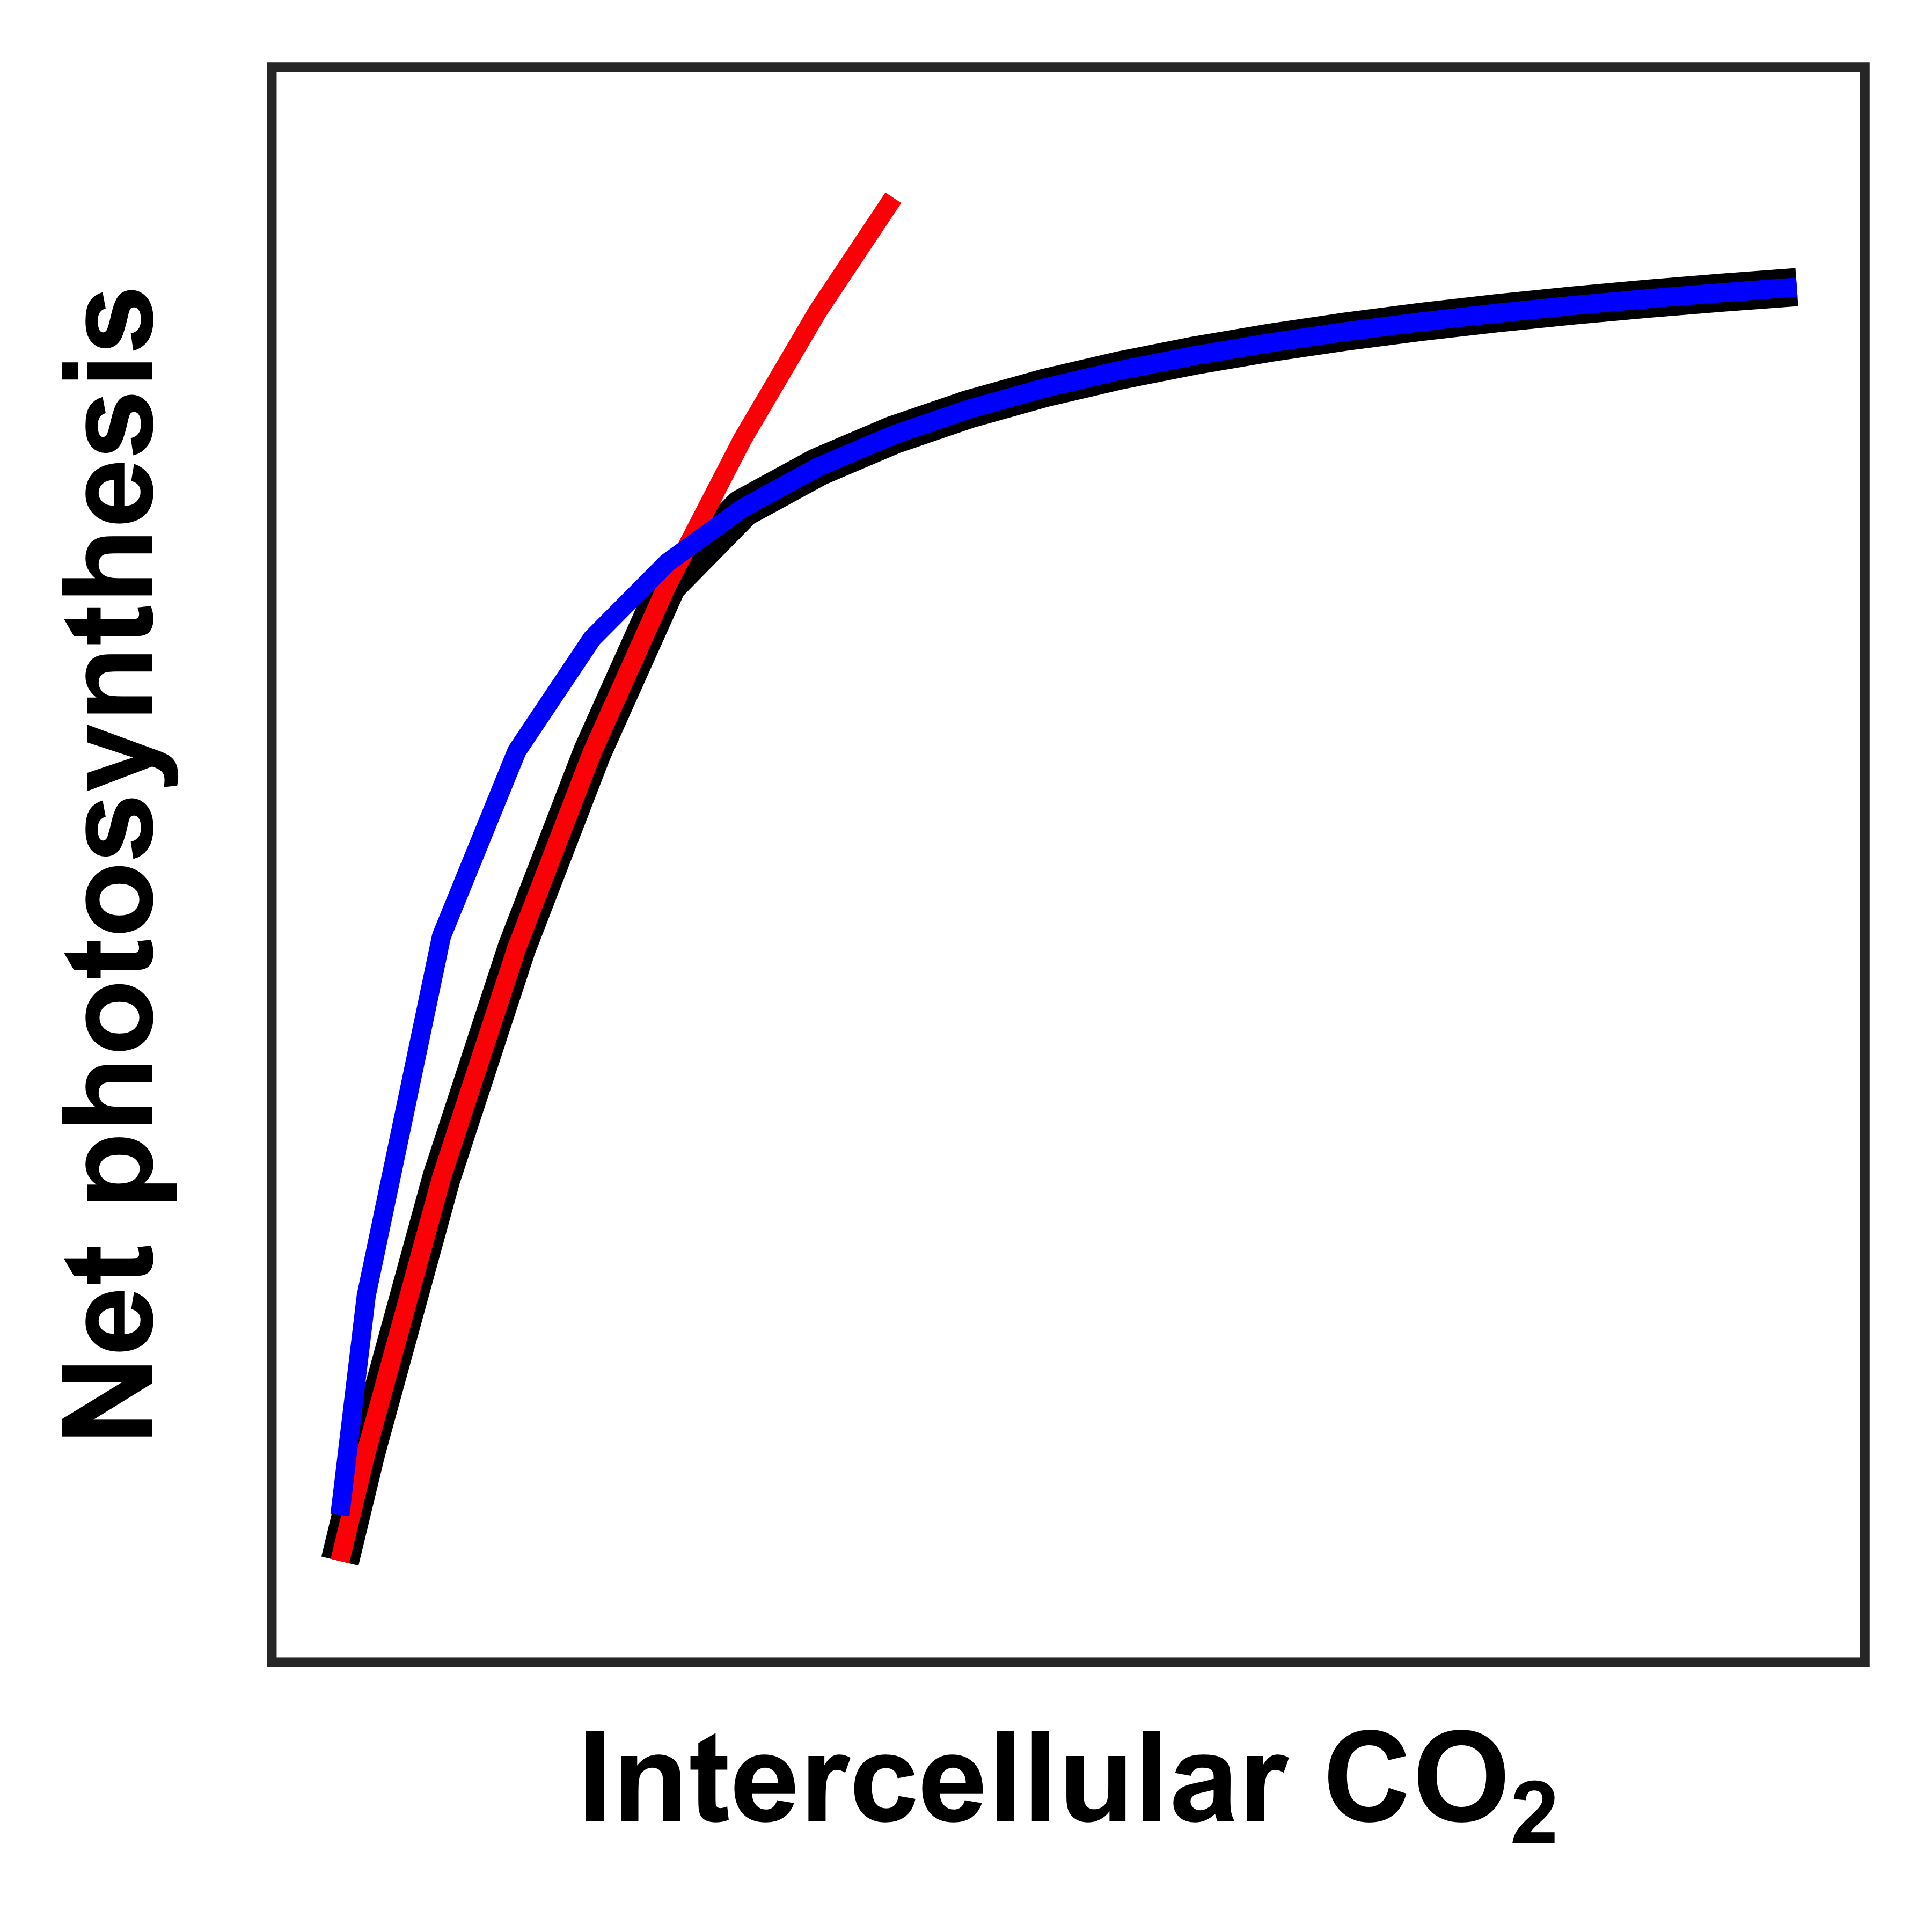
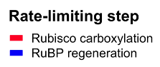
Data processing
Fit A/Ci curves, extract snapshot physiology measurements:
Anet (snapshot)
Stomatal conductance (snapshot)
Leaf Ci (snapshot)
iWUE (snapshot, not currently in dataset, but could be)
Stomatal limitation (snapshot, not currently in dataset, but could be)
Apparent maximum rate of Rubisco carboxylation (Vcmax, from A/Ci curve)
Apparent maximum rate of electron transport for RuBP regeneration (Jmax, from A/Ci curve)

Slide 4
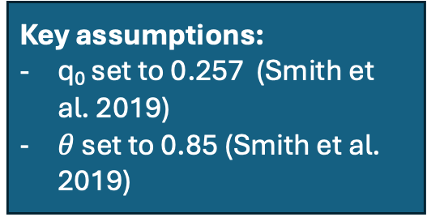
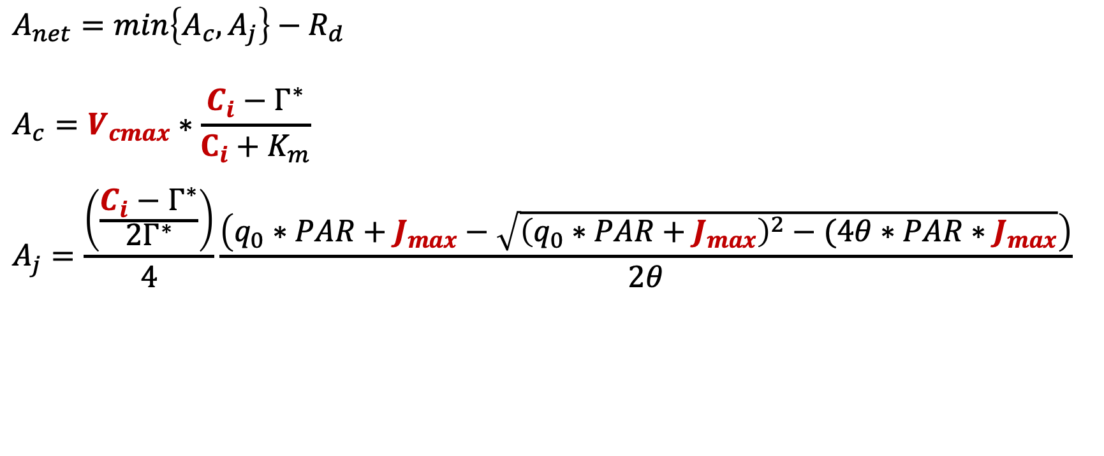
Photosynthesis model
Key assumptions:
q₀ set to 0.257 (Smith et al. 2019)
$θ$ set to 0.85 (Smith et al. 2019)
$$A_{net}=min\left\{A_{c}, A_{j}\right\}−R_{d}$$
$$A_{c}=V_{cmax}∗\frac{C_{i}−Γ^{∗}}{C_{i}+K_{m}}$$
$$A_{j}=\frac{\left(\frac{C_{i}−Γ^{∗}}{{2Γ}^{∗}}\right)}{4}\frac{\left(q_{0}∗PAR+J_{max}−\sqrt{{\left(q_{0}∗PAR+J_{max}\right)}^{2}−(4θ∗PAR∗J_{max}}\right)}{2θ}$$

Slide 5
Photosynthesis model
Key assumptions:
q₀ set to 0.257 (Smith et al. 2019)
$θ$ set to 0.85 (Smith et al. 2019)
$$A_{net}=min\left\{A_{c}, A_{j}\right\}−R_{d}$$
$$A_{c}=V_{cmax}∗\frac{C_{i}−Γ^{∗}}{C_{i}+K_{m}}$$
$$A_{j}=\frac{\left(\frac{C_{i}−Γ^{∗}}{{2Γ}^{∗}}\right)}{4}\frac{\left(q_{0}∗PAR+J_{max}−\sqrt{{\left(q_{0}∗PAR+J_{max}\right)}^{2}−(4θ∗PAR∗J_{max}}\right)}{2θ}$$
We can use daily estimates of V_{cmax}, J_{max}, and C_{i} and hourly PAR and temperature measurements (Γ* and K_{m} are functions of temperature) to estimate hourly C gain, then scale to daily C gain as sum of hourly C gain values per day

Slide 6
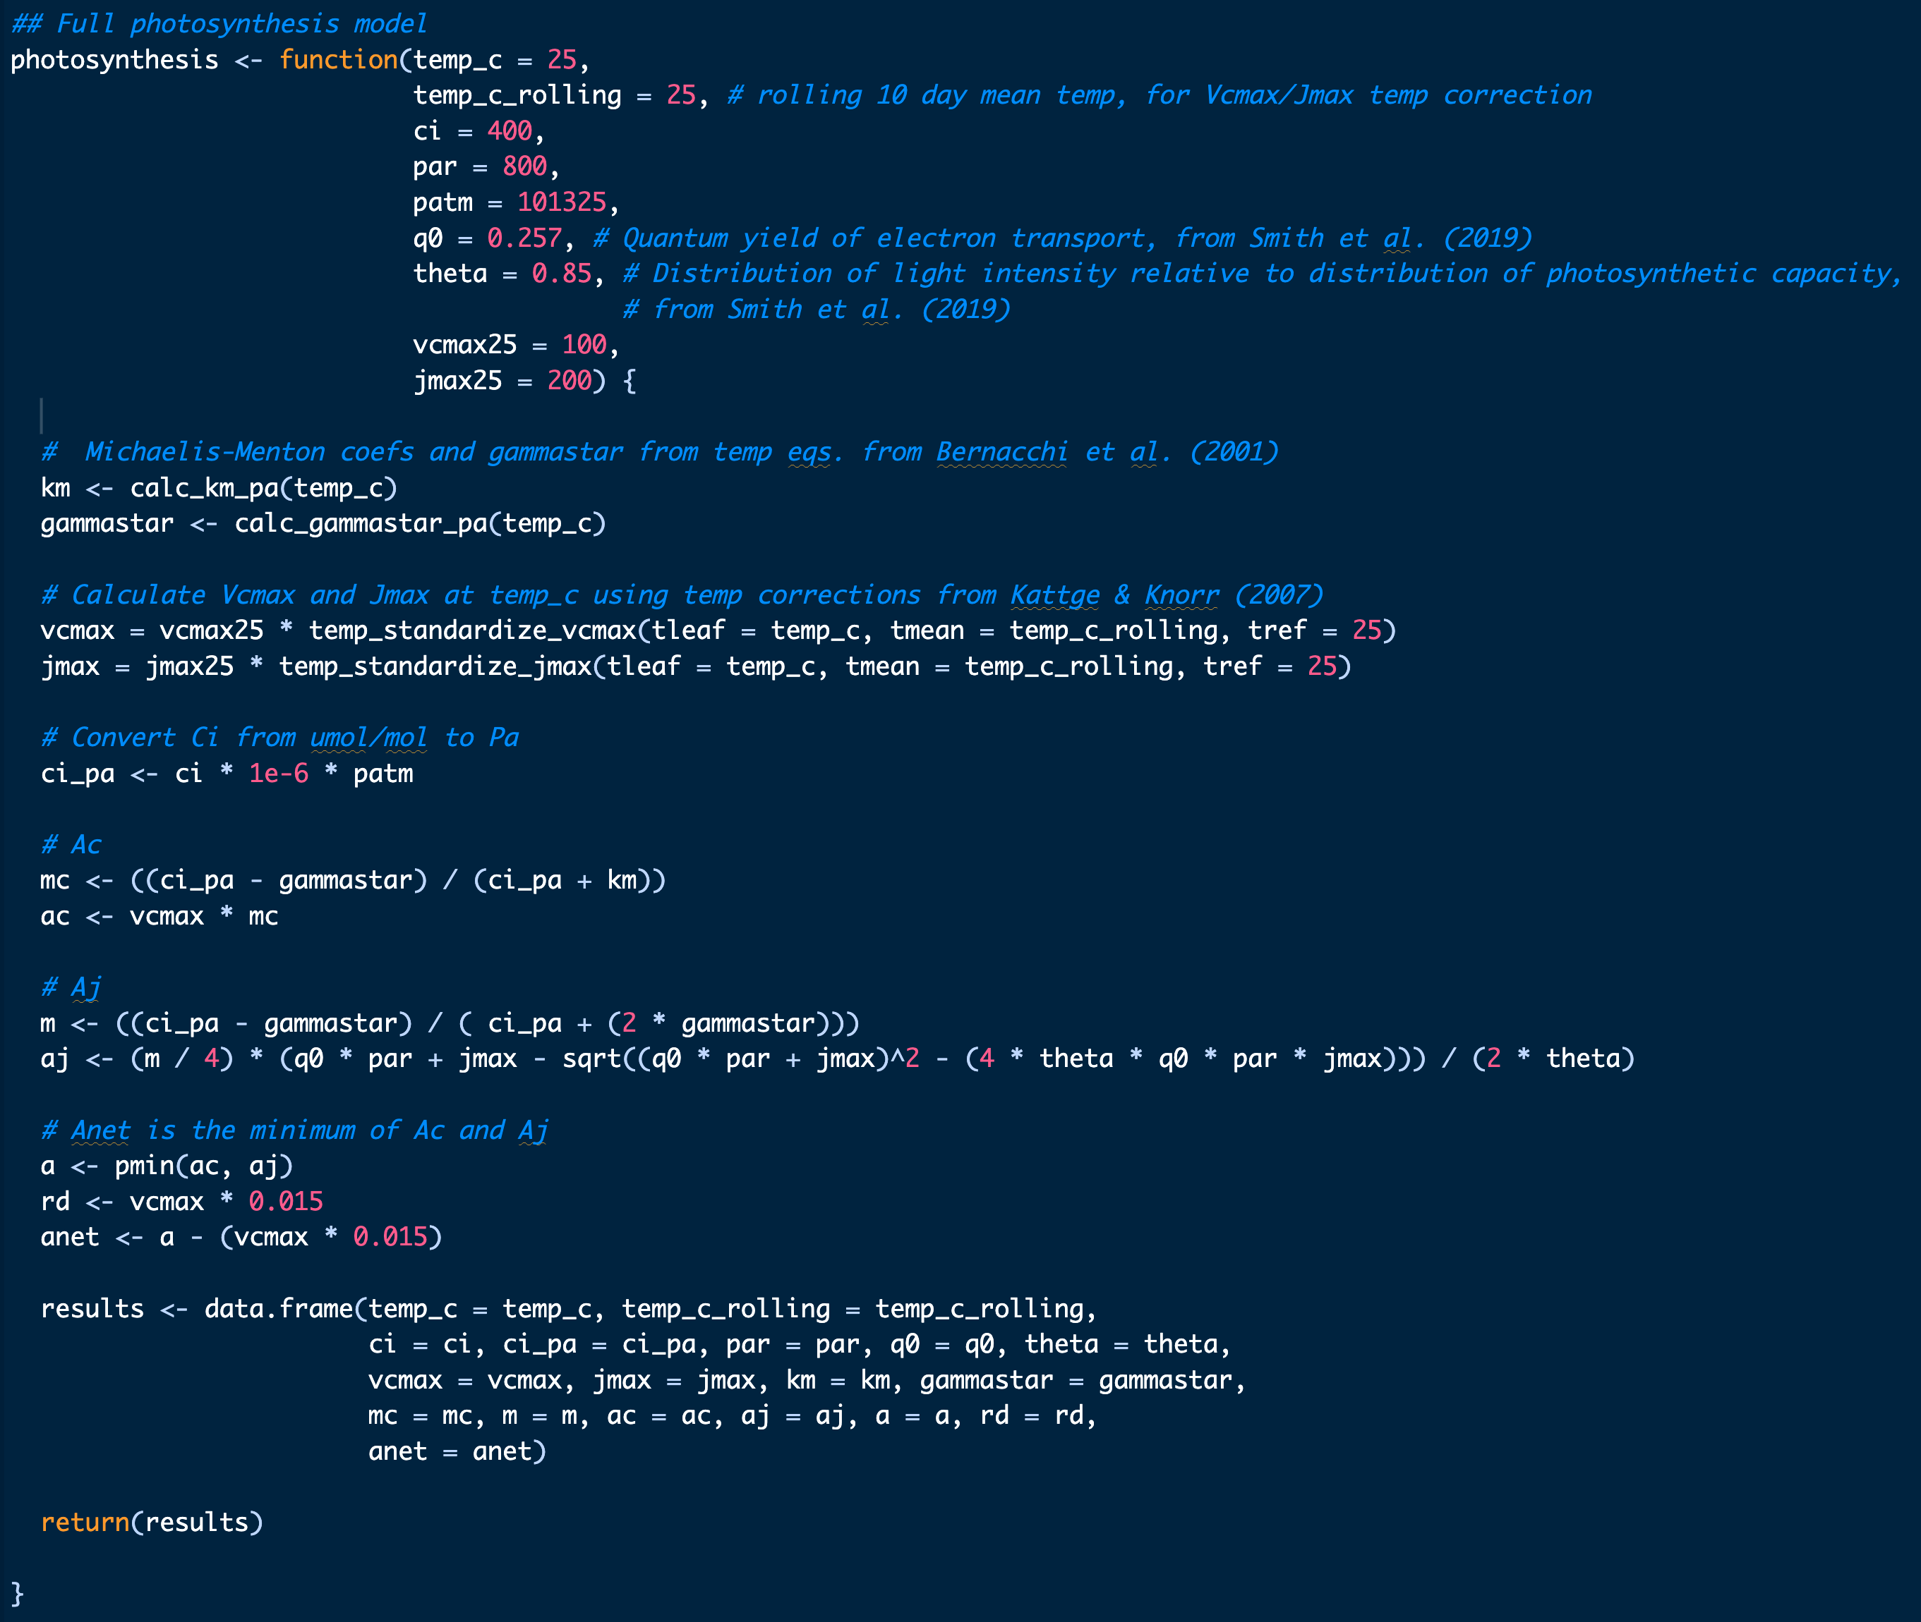

Slide 7
Carbon budget approach (ignoring size classes for now)
Create linear mixed models for V_{cmax25}, J_{max25}, C_{i}
Trait ~ gm_trt * doy + (1 | id) + (1 | plot)
Bootstrap model predictions for each trait to generate predicted values of V_{cmax}, J_{max}, and C_{i} for each gm_trt for each day
150 iterations for each gm_trt for now
Merge bootstrapped predictions into hourly climate dataset
150 iterations * 2 gm_trt = 300 rows of each trait per hour for each day)
Run photosynthesis model for all rows
Returns Ac, Aj, Anet, A, Rd predictions
Convert Ac, Aj, Anet (total net C gain), A (C gain), Rd (C lost) from μmol/m2/s to g CO2/m2/hr
Randomly sample one Anet, A, and Rd value per hour per day, then estimate total net daily C gain (from Anet), daily C gain (from A) and daily C lost (from Rd) (g CO2/m2/day) as sum of each randomly sampled hourly estimate
Iterate random sampling 1000 times per day, calculate summary statistics (mean, SD, SE, 95% CI intervals) and cumulative sum of total net daily C gain, daily C gain, daily C lost across growing season

Slide 8
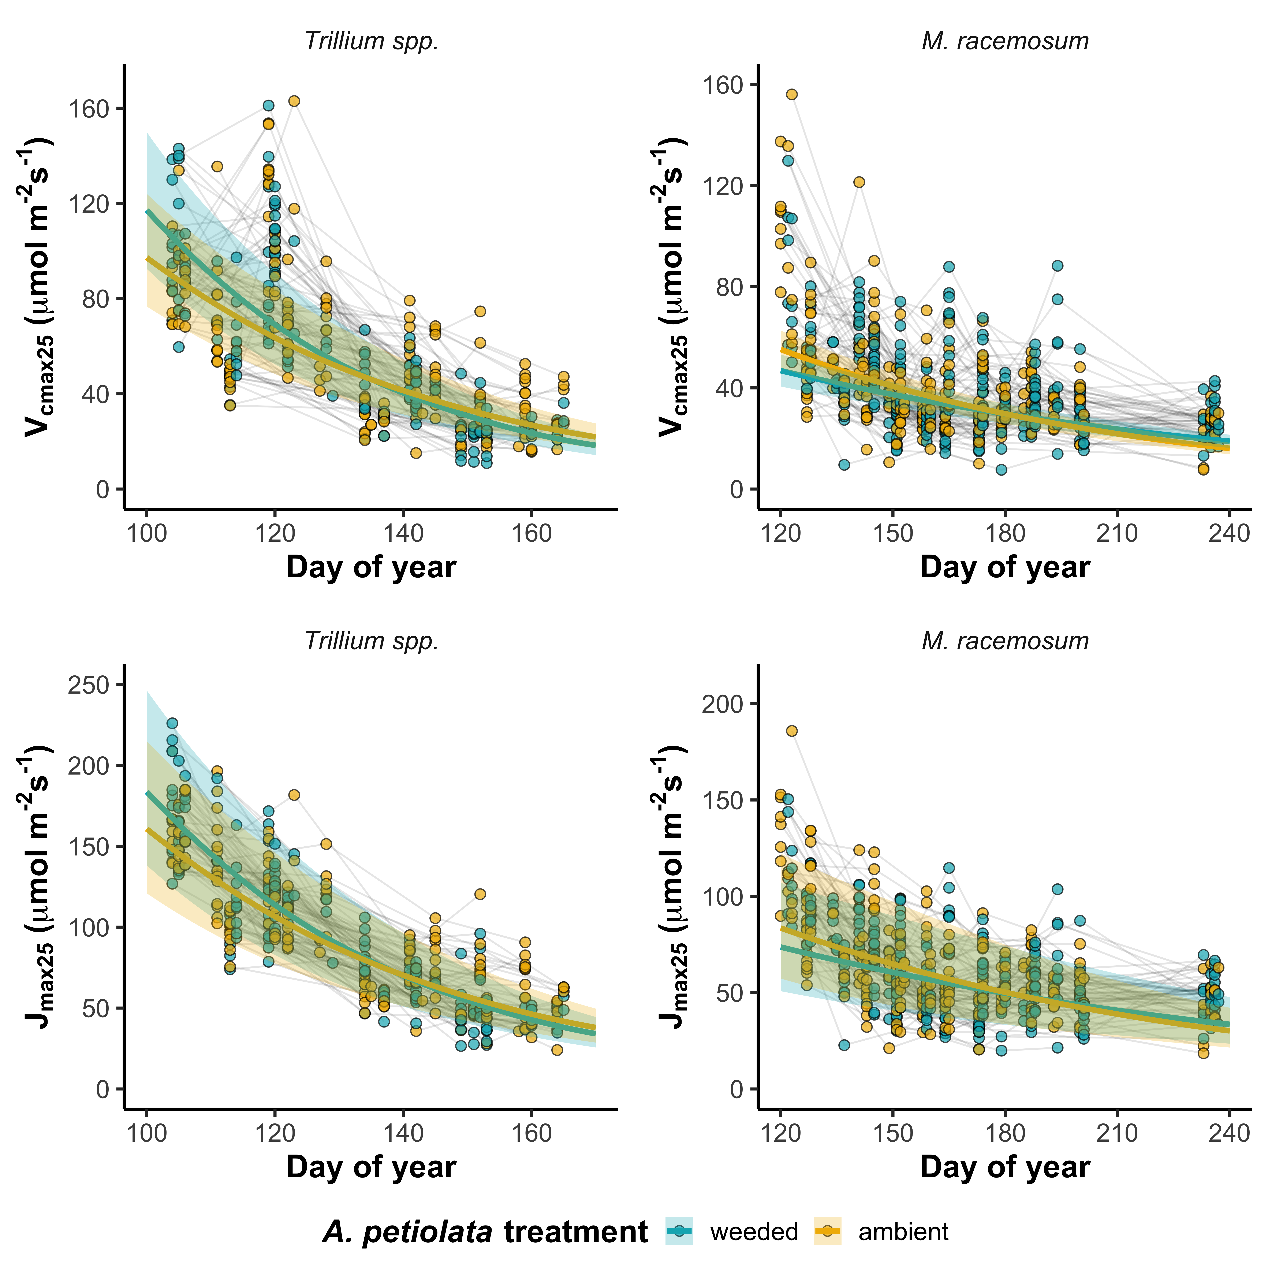
Carbon budget approach (ignoring size classes for now)
GM trt: p=0.590
DOY: p<0.001
GM*DOY: p=0.006
GM trt: p=0.390
DOY: p<0.001
GM*DOY: p=0.004
Create linear mixed models for V_{cmax25}, J_{max25}, C_{i}
Trait ~ gm_trt * doy + (1 | id) + (1 | plot)
Bootstrap model predictions for each trait to generate predicted values of V_{cmax}, J_{max}, and C_{i} for each gm_trt for each day
150 iterations for each gm_trt for now
Merge bootstrapped predictions into hourly climate dataset
150 iterations * 2 gm_trt = 300 rows of each trait per hour for each day)
Run photosynthesis model for all rows
Returns Ac, Aj, Anet, A, Rd predictions
Convert Ac, Aj, Anet (total net C gain), A (C gain), Rd (C lost) from μmol/m2/s to g CO2/m2/hr
Randomly sample one Anet, A, and Rd value per hour per day, then estimate total net daily C gain (from Anet), daily C gain (from A) and daily C lost (from Rd) (g CO2/m2/day) as sum of each randomly sampled hourly estimate
Iterate random sampling 1000 times per day, calculate summary statistics (mean, SD, SE, 95% CI intervals) and cumulative sum of total net daily C gain, daily C gain, daily C lost across growing season
GM trt: p=0.338
DOY: p<0.001
GM*DOY: p=0.004
GM trt: p=0.318
DOY: p<0.001
GM*DOY: p=0.020

Slide 9
Carbon budget approach (ignoring size classes for now)
GM trt: p=0.590
DOY: p<0.001
GM*DOY: p=0.006
GM trt: p=0.390
DOY: p<0.001
GM*DOY: p=0.004
Create linear mixed models for V_{cmax25}, J_{max25}, C_{i}
Trait ~ gm_trt * doy + (1 | id) + (1 | plot)
Bootstrap model predictions for each trait to generate predicted values of V_{cmax}, J_{max}, and C_{i} for each gm_trt for each day
150 iterations for each gm_trt for now (can expand)
Merge bootstrapped predictions into hourly climate dataset
150 iterations * 2 gm_trt = 300 rows of each trait per hour for each day)
Run photosynthesis model for all rows
Returns Ac, Aj, Anet, A, Rd predictions
Convert Ac, Aj, Anet (total net C gain), A (C gain), Rd (C lost) from μmol/m2/s to g CO2/m2/hr
Randomly sample one Anet, A, and Rd value per hour per day, then estimate total net daily C gain (from Anet), daily C gain (from A) and daily C lost (from Rd) (g CO2/m2/day) as sum of each randomly sampled hourly estimate
Iterate random sampling 1000 times per day, calculate summary statistics (mean, SD, SE, 95% CI intervals) and cumulative sum of total net daily C gain, daily C gain, daily C lost across growing season
GM trt: p=0.338
DOY: p<0.001
GM*DOY: p=0.004
GM trt: p=0.318
DOY: p<0.001
GM*DOY: p=0.020

Slide 10
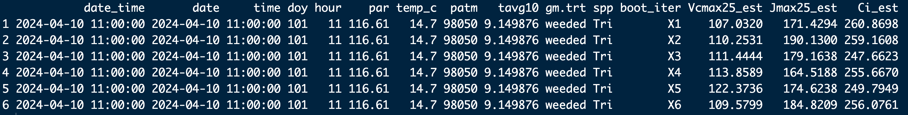
Carbon budget approach (ignoring size classes for now)
Create linear mixed models for V_{cmax25}, J_{max25}, C_{i}
Trait ~ gm_trt * doy + (1 | id) + (1 | plot)
Bootstrap model predictions for each trait to generate predicted values of V_{cmax}, J_{max}, and C_{i} for each gm_trt for each day
150 iterations for each gm_trt for now (can expand)
Merge bootstrapped predictions into hourly climate dataset
150 iterations * 2 gm_trt = 300 rows of each trait per hour for each day)
Run photosynthesis model for all rows
Returns Ac, Aj, Anet, A, Rd predictions
Convert Ac, Aj, Anet (total net C gain), A (C gain), Rd (C lost) from μmol/m2/s to g CO2/m2/hr
Randomly sample one Anet, A, and Rd value per hour per day, then estimate total net daily C gain (from Anet), daily C gain (from A) and daily C lost (from Rd) (g CO2/m2/day) as sum of each randomly sampled hourly estimate
Iterate random sampling 1000 times per day, calculate summary statistics (mean, SD, SE, 95% CI intervals) and cumulative sum of total net daily C gain, daily C gain, daily C lost across growing season

Slide 11
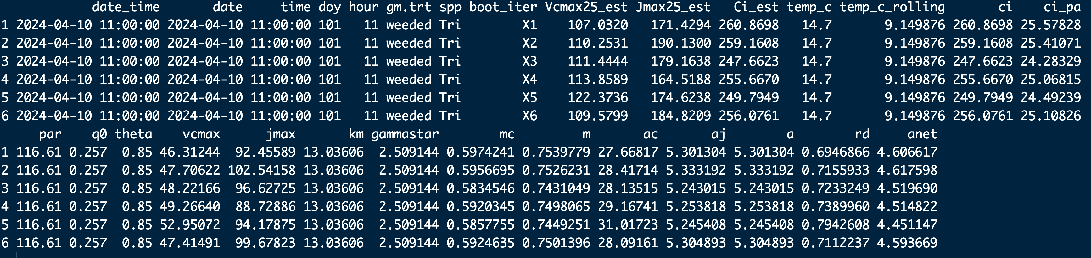
Carbon budget approach (ignoring size classes for now)
Create linear mixed models for V_{cmax25}, J_{max25}, C_{i}
Trait ~ gm_trt * doy + (1 | id) + (1 | plot)
Bootstrap model predictions for each trait to generate predicted values of V_{cmax}, J_{max}, and C_{i} for each gm_trt for each day
150 iterations for each gm_trt for now (can expand)
Merge bootstrapped predictions into hourly climate dataset
150 iterations * 2 gm_trt = 300 rows of each trait per hour for each day)
Run photosynthesis model for all rows
Returns Ac, Aj, Anet, A, Rd predictions
Convert Ac, Aj, Anet (total net C gain), A (C gain), Rd (C lost) from μmol/m2/s to g CO2/m2/hr
Randomly sample one Anet, A, and Rd value per hour per day, then estimate total net daily C gain (from Anet), daily C gain (from A) and daily C lost (from Rd) (g CO2/m2/day) as sum of each randomly sampled hourly estimate
Iterate random sampling 1000 times per day, calculate summary statistics (mean, SD, SE, 95% CI intervals) and cumulative sum of total net daily C gain, daily C gain, daily C lost across growing season

Slide 12
Carbon budget approach (ignoring size classes for now)
Create linear mixed models for V_{cmax25}, J_{max25}, C_{i}
Trait ~ gm_trt * doy + (1 | id) + (1 | plot)
Bootstrap model predictions for each trait to generate predicted values of V_{cmax}, J_{max}, and C_{i} for each gm_trt for each day
150 iterations for each gm_trt for now (can expand)
Merge bootstrapped predictions into hourly climate dataset
150 iterations * 2 gm_trt = 300 rows of each trait per hour for each day)
Run photosynthesis model for all rows
Returns Ac, Aj, Anet, A, Rd predictions
Convert Ac, Aj, Anet (total net C gain), A (C gain), Rd (C lost) from μmol/m2/s to g CO2/m2/hr
Randomly sample one Anet, A, and Rd value per hour per day, then estimate total net daily C gain (from Anet), daily C gain (from A) and daily C lost (from Rd) (g CO2/m2/day) as sum of each randomly sampled hourly estimate
Iterate random sampling 1000 times per day, calculate summary statistics (mean, SD, SE, 95% CI intervals) and cumulative sum of total net daily C gain, daily C gain, daily C lost across growing season

Slide 13
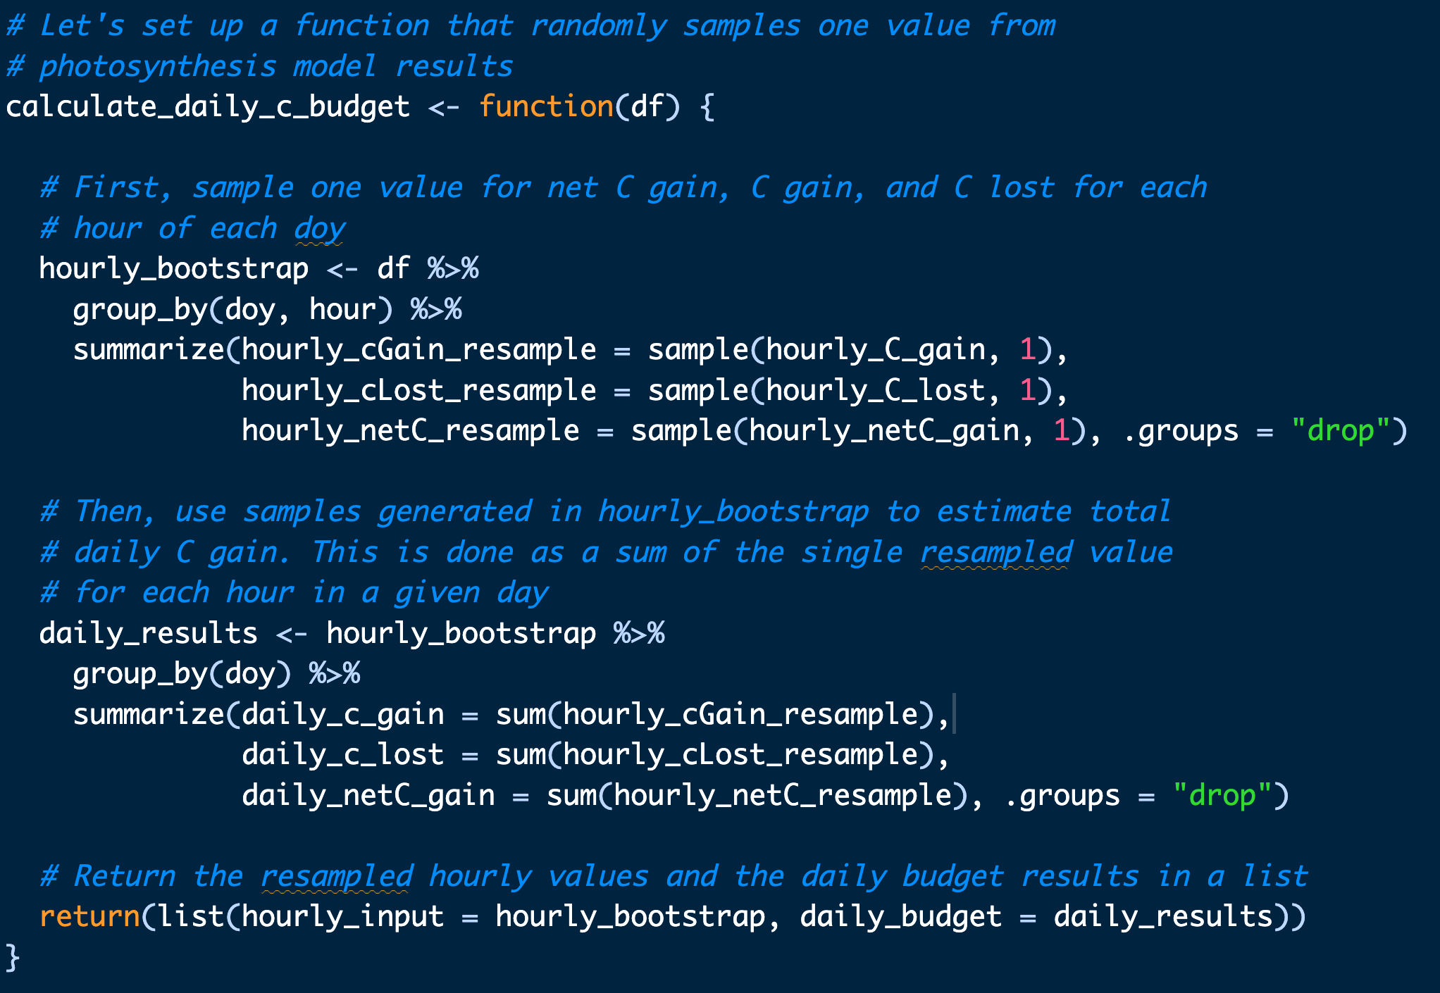
Carbon budget approach (ignoring size classes for now)
Create linear mixed models for V_{cmax25}, J_{max25}, C_{i}
Trait ~ gm_trt * doy + (1 | id) + (1 | plot)
Bootstrap model predictions for each trait to generate predicted values of V_{cmax}, J_{max}, and C_{i} for each gm_trt for each day
150 iterations for each gm_trt for now (can expand)
Merge bootstrapped predictions into hourly climate dataset
150 iterations * 2 gm_trt = 300 rows of each trait per hour for each day)
Run photosynthesis model for all rows
Returns Ac, Aj, Anet, A, Rd predictions
Convert Ac, Aj, Anet (total net C gain), A (C gain), Rd (C lost) from μmol/m2/s to g CO2/m2/hr
Randomly sample one Anet, A, and Rd value per hour per day, then estimate total net daily C gain (from Anet), daily C gain (from A) and daily C lost (from Rd) (g CO2/m2/day) as sum of each randomly sampled hourly estimate
Iterate random sampling 1000 times per day, calculate summary statistics (mean, SD, SE, 95% CI intervals) and cumulative sum of total net daily C gain, daily C gain, daily C lost across growing season

Slide 14
Carbon budget approach (ignoring size classes for now)
Create linear mixed models for V_{cmax25}, J_{max25}, C_{i}
Trait ~ gm_trt * doy + (1 | id) + (1 | plot)
Bootstrap model predictions for each trait to generate predicted values of V_{cmax}, J_{max}, and C_{i} for each gm_trt for each day
150 iterations for each gm_trt for now (can expand)
Merge bootstrapped predictions into hourly climate dataset
150 iterations * 2 gm_trt = 300 rows of each trait per hour for each day)
Run photosynthesis model for all rows
Returns Ac, Aj, Anet, A, Rd predictions
Convert Ac, Aj, Anet (total net C gain), A (C gain), Rd (C lost) from μmol/m2/s to g CO2/m2/hr
Randomly sample one Anet, A, and Rd value per hour per day, then estimate total net daily C gain (from Anet), daily C gain (from A) and daily C lost (from Rd) (g CO2/m2/day) as sum of each randomly sampled hourly estimate
Iterate random sampling 1000 times per day, calculate summary statistics (mean, SD, SE, 95% CI intervals) and cumulative sum of total net daily C gain, daily C gain, daily C lost across growing season
* 1000 iterations

Slide 15
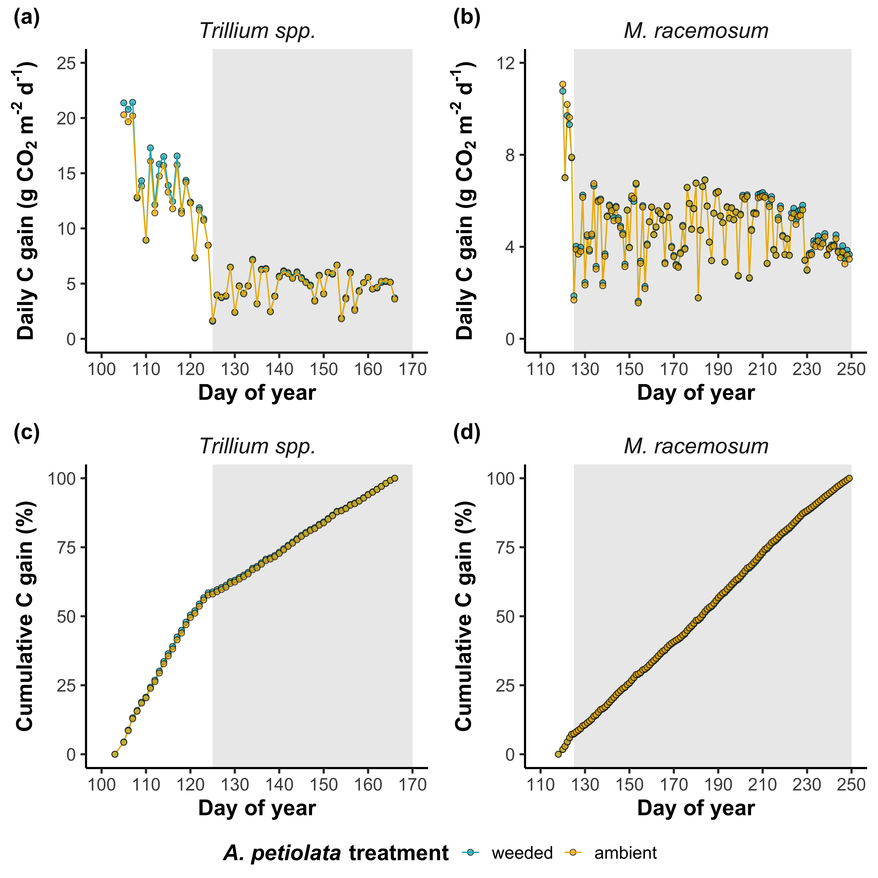
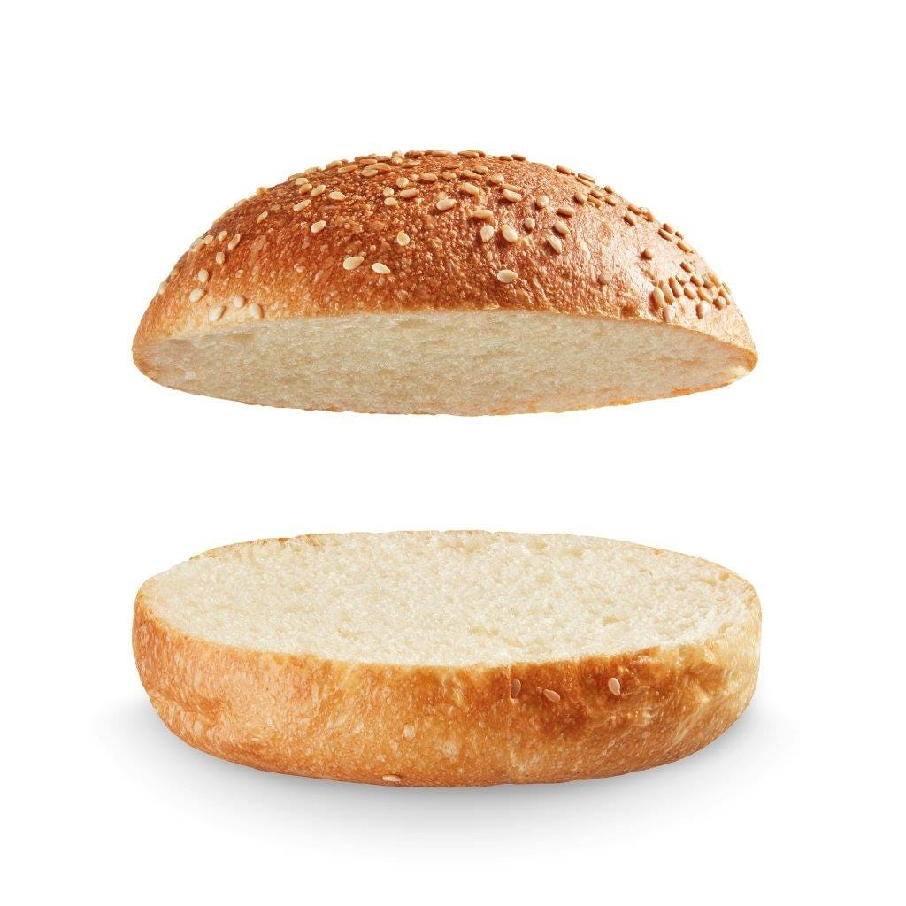
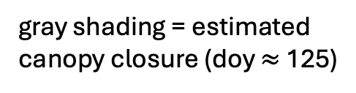
Null effect of GM treatment on cumulative C gain
Size classes?
gray shading = estimated
canopy closure (doy $≈$ 125)

Slide 16
Null effects of GM treatment on daily and cumulative C gain despite fact that GM treatment still impacted V_{cmax25}, J_{max25}, C_{i}
GM trt: p=0.590
DOY: p<0.001
GM*DOY: p=0.006
GM trt: p=0.338
DOY: p<0.001
GM*DOY: p=0.004
GM trt: p=0.616
DOY: p<0.001
GM*DOY: p=0.026
GM trt: p=0.390
DOY: p<0.001
GM*DOY: p=0.004
GM trt: p=0.318
DOY: p<0.001
GM*DOY: p=0.020
GM trt: p=0.175
DOY: p<0.001
GM*DOY: p=0.446

Slide 17
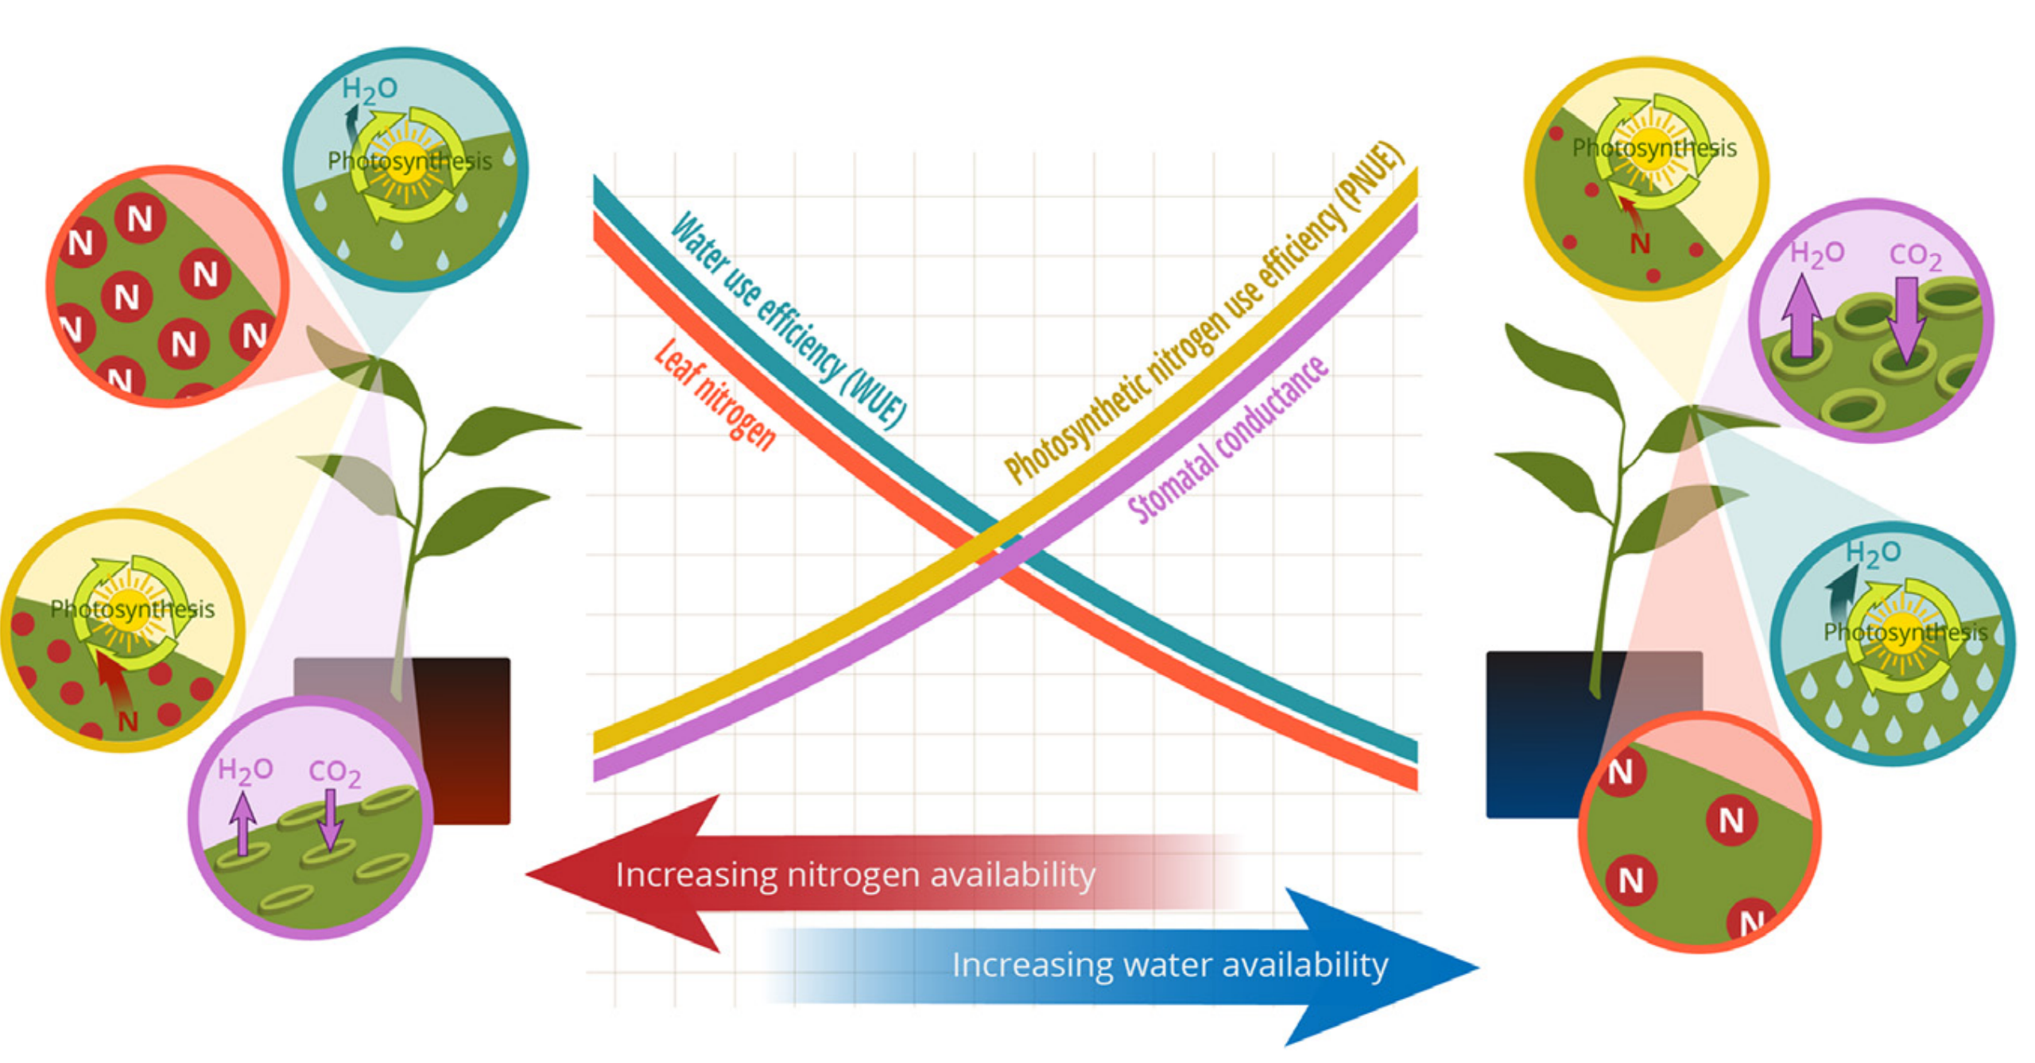
Might suggest that GM trt modifies nitrogen-water use tradeoffs despite no effect on net C budget (least-cost theory)?
(V_{cmax25}, J_{max25})
(C_{i})
Bialic-Murphy et al. (2021)

Slide 18
Next steps
Might these responses be size-dependent?
Expectation: younger, smaller plants may experience stronger negative effects of garlic mustard
Generally more productive
Might rely more on disrupted AMF for soil resources
Older plants may have had enough time to adapt strategies to compensate for negative GM impacts
Discretize initial plant size into 5 bins. Two options:
Discretize such that all individuals equally fall into bins
Discretize such that the standard deviation in size across individuals is equal across bins
Use same C budgeting approach
Process harvested leaf samples
LMA (leaf dry biomass per unit leaf area)
Leaf carbon and nitrogen (maybe phosphorus?) content
Leaf d¹³C (time-integrated ratio of leaf Ci:Ca)
Leaf d¹⁵N (proxy for N acquired from AMF)

